Slide 1
AMAZON SALES
DATA ANALYSIS REPORT
Sangeeta Nuchhi

Slide 2
Problem Statement
Sales management has gained importance to meet increasing competition and the need for improved methods of distribution to reduce cost and to increase profits.
Sales management today is the most important function in a commercial and business enterprise.
Do ETL: Extract-Transform-Load some Amazon dataset and find for me Sales-trend -> month-wise, year-wise, yearly_month-wise Find key metrics and factors and show the meaningful relationships between attributes. Do your own research and come up with your findings.
Help out to make better business decisions.
Help analyze customer trends and satisfaction, which can lead to new and better products and services.
Gives better insight of customers base.
Helps in easy flow for managing resources.

Slide 3
To calculate total sales, total profit, average profit margin and average unit price
To find yearly total sales
To find total sales and total profit by region
er of units sold of a particular item type
To calculate total sales, total profit, average profit margin and average unit price
To find yearly total sales
To find total sales and total profit by region
To find the number of units sold of a particular item type
To find which order priority gave highest sales.
To find which is the bestseller Item type
To find which mode of channel generated maximum sales
To find yearly total sales
Objective:

Slide 4
Quick Insight
﻿A quick insight for 2017 | 2018 | 2019 amazon sales.
137.35M
Total Revenue
44.17M
Sum of total profits
32.16
Average profit margin
27.68K
Sum of unit Price

Slide 5
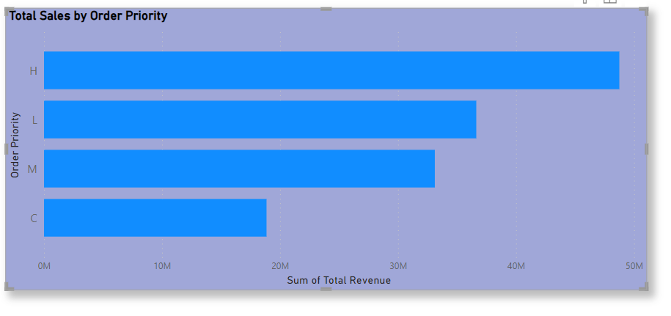
Total Sales by order priority
﻿

Slide 6
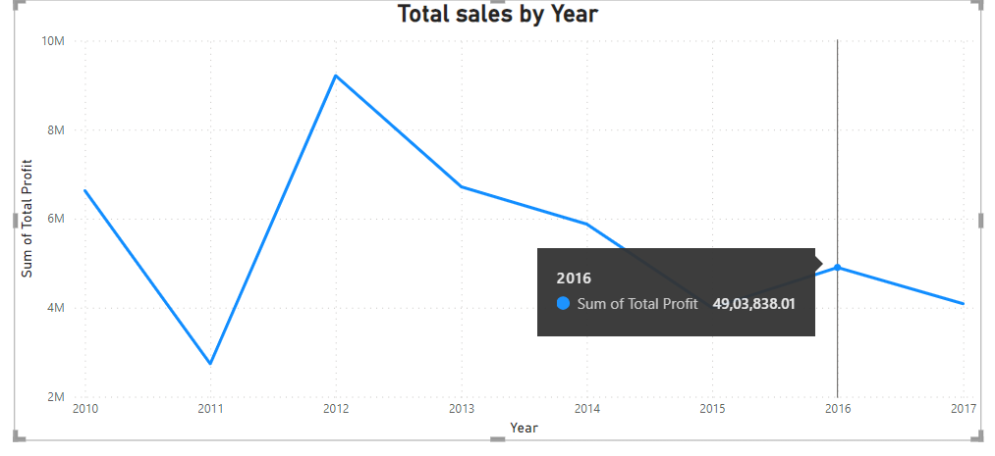
Total units sold per year
.

Slide 7
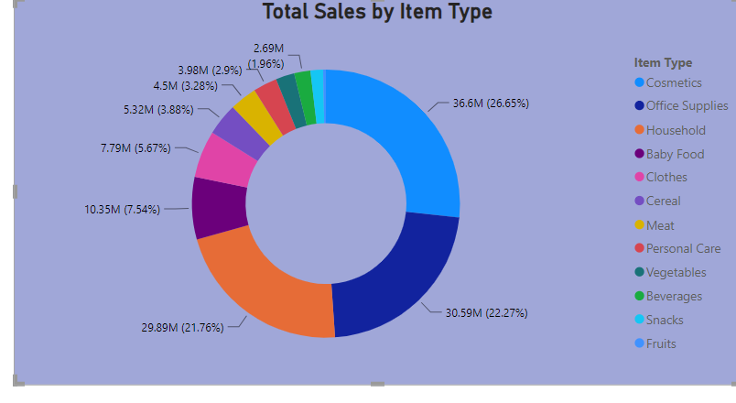
Total units sold by item type
﻿.

Slide 8
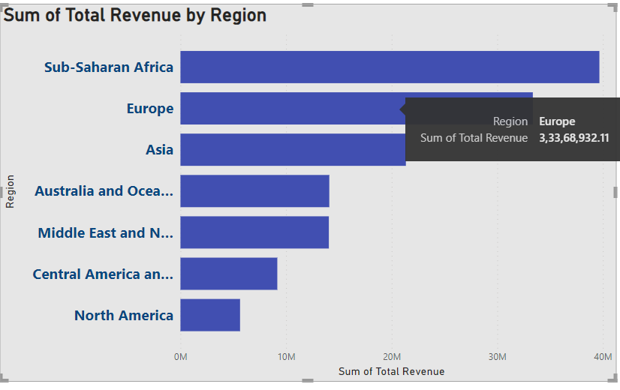
Total Revenue By region

Slide 9
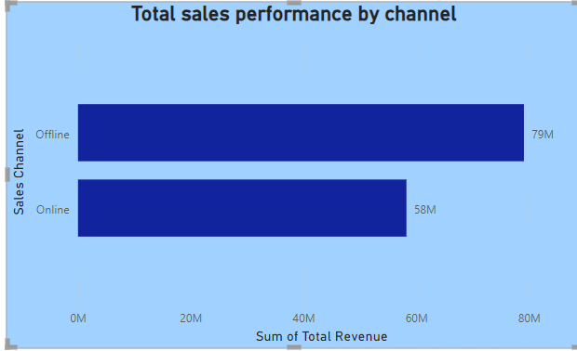
Total sales performance by channel
.

Slide 10
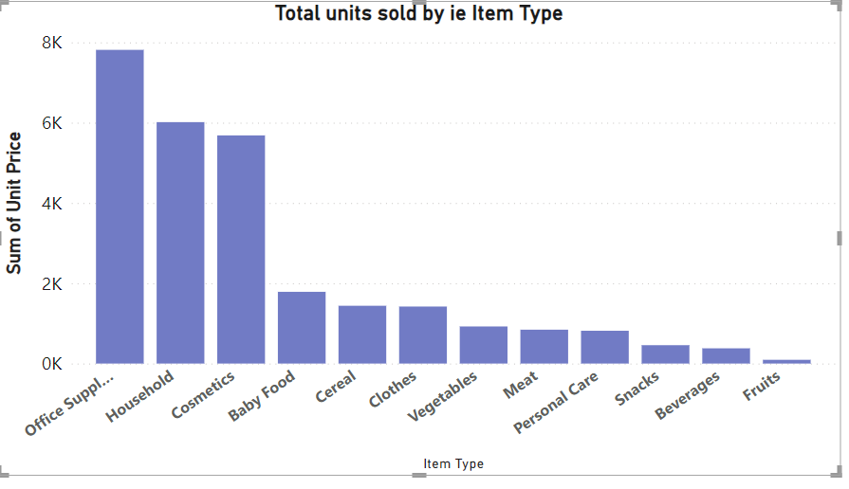
Total units sold by item type

Slide 11
Conclusion
Cosmetic products are very popular among people of Europe and these products generated the highest profit ($14.56 million) of all items. So, it is advisable to create some marketing campaigns promoting Cosmetic products.
Total Population of North America prefer to shop offline as compared to people of Europe, who mostly prefer Online channel for shopping. But because high profits are coming from Online channel, it advisable to promote products online.
The Region Sub-Saharan Africa has generated the highest profit where people bought Fruits the most, with approx. 31 thousands unit sold. Highlight the health benefits of fruits during campaigns and align marketing with local preferences.
The second most purchased item, after Cosmetics in Europe is Baby Food. This insight tells us that majority of people of Europe are newlywed couples. Thus you can promote products related to new born babies to these people

Slide 12
Fruits has generated the least profit of all item types which is only $120.50 thousands. It is advisable to understand the customer needs, adjust the price and analyse the local preference.
North America Region has generated the least profit by selling only Personal Care and Household Items through Offline Channel. Try to promote products other than both these item types through Online Channel by giving some discounts. Do some survey to find local people’s preferences.
Meat is the least sold item type with 11 thousands units sold in Australia and Oceania and Sub-Saharan Africa Region using only Online Channel. Consider selling different kinds of meat products and adjust the prices.
Household Items and Cosmetic Products are sold the most through Offline and Online Channels respectively. Enhance physical stores with attractive displays and promotions for Household Items. Run targeted ads and make the website more user friendly for Cosmetic products

